Slide 1


Presentation by: Mr Thamsanqa Zikode
Head of Portfolio
Auditor-General South Africa (AGSA)
Auditing in the public sector
Tuesday 20 February 2024

Slide 2


Mission and Vision
VISION
To be recognised by all our stakeholders as a relevant Supreme Audit Institution (SAI) that enhances public sector accountability
MISSION
The Auditor-General of South Africa has a constitutional mandate and, as the supreme audit institution of South Africa, exists to strengthen our country’s democracy by enabling oversight, accountability and governance in the public sector through auditing, thereby building public confidence

Slide 3

Why public sector auditing
The mandate of the AGSA to audit public sector institutions, is derived from the Constitution of the Republic of South Africa (Constitution). In addition, the Public Audit Act (PAA) prescribes the functions of the AGSA. The scope of the annual audit in the public sector includes the audit of the financial statements, reported performance information and compliance with key legislation. Furthermore, the AGSA may perform discretionary engagements such as performance audits, investigations and special audits.
In general, public sector auditing can be described as a systematic process of objectively obtaining and evaluating evidence to determine whether information or actual conditions conform to established criteria. Public sector auditing is essential because it provides those charged with governance, legislative and oversight bodies and the general public with assurance on published information as well as independent and objective assessments concerning the stewardship and performance of government policies, programmes or operations.

Slide 4
Why public sector auditing
Key stakeholders in the public sector include Parliament, provincial legislatures and their respective committees, national and provincial treasuries, executive authorities, municipal councils, accounting officers and the public at large. When auditing in the public sector, it is important to have an understanding of the three different spheres of government, i.e. national, provincial and local, and how they interact with one another.
Public sector institutions operate within a complex legislative framework. In that context, it is important for public sector auditors to understand the legislation applicable to the institutions they audit.
The International Organisation of Supreme Audit Institutions (INTOSAI) operates as an umbrella organisation for government external audit community. It provides an institutionalised framework for supreme audit institutions (SAIs) to promote development, transfer knowledge and improve government auditing worldwide. The AGSA is a member of INTOSAI.

Slide 5
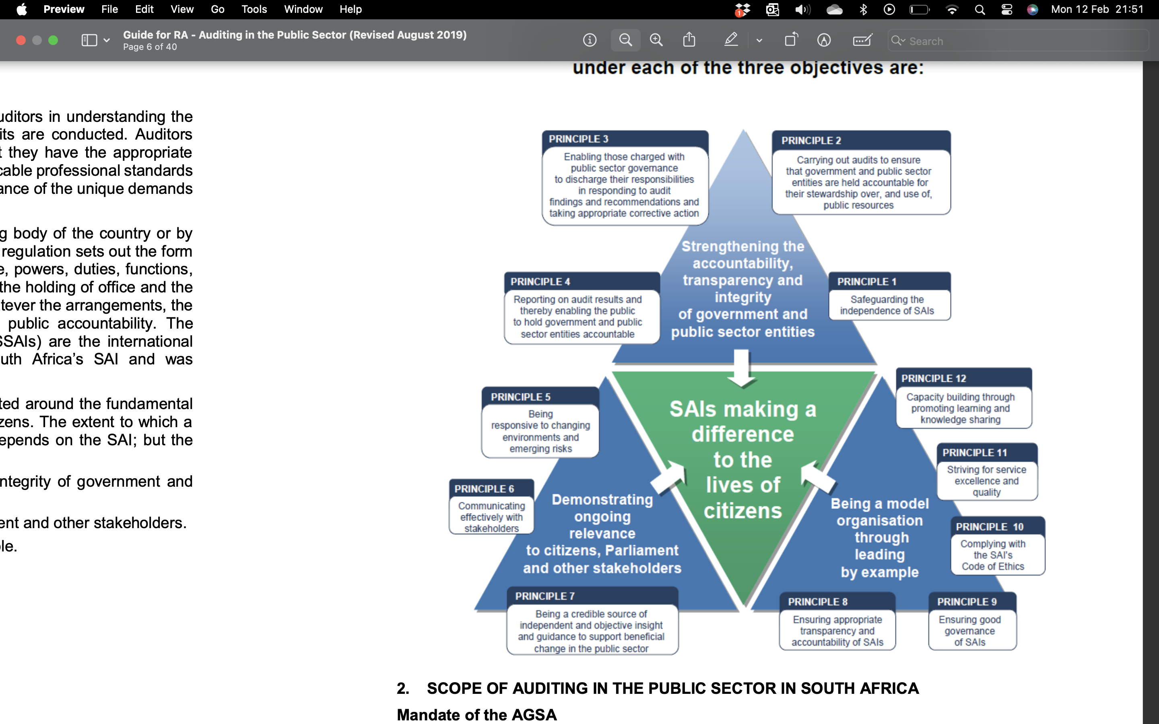
Public Sector Auditing: A national mandate

Slide 6
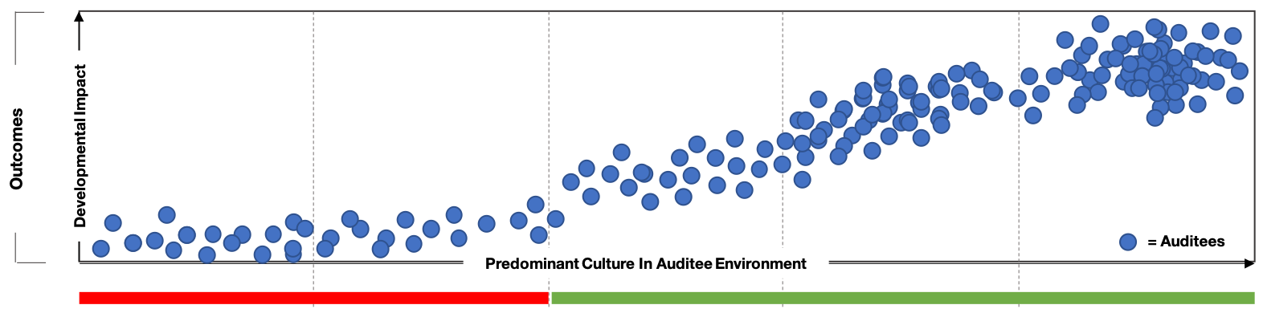
#CultureShift2030 Strategy aims to shift gears on public sector auditing
Outcomes will not change materially if focus is not on shifting public sector culture
Our commitment: to make a more direct, consistent and meaningful impact on improving lives of ordinary South Africans through #cultureshift2030
Strategic aspiration
To have stronger, more direct and consistent impact on improving lived reality of ordinary South Africans
Theory of change
Sustainably and efficiently shift public sector culture through insight, influence and enforcement
Accountability ecosystem
Broad-based, effective network of stakeholders driving and deepening public sector accountability
Doing harm
Doing nothing
Doing the basics
Doing no harm
Doing good

Slide 7
#CultureShift Strategy2030
Shift Public Sector Culture
INSIGHT
INSIGHT
Stakeholder Insights and Needs
Product Vision
Real-Time audit approach
AOPO linked to service delivery
Data analytics
Data driven audits
Fraud analytics
Benchmarking
Research
INFLUENCE
Accountability Ecosystem campaign
Culture Shift coalition program
Strengthening oversight bodies
Capacitation of staff on art of influence
SUSTAINABLY / EFFICIENCY
Quality impact and timely audits
CWC, resource utilization & Ahluma
Audit team & audit support collaboration
CSO collaboration
AOPO and DAM methodology
Timely issued guidance
Identification of data needs
Audit Software Project (ASP)
Review of methodology
ENFORCE
Quality and impactful MIs
Effective MI process
Efficiently managed MI process

Slide 8
Accountability ecosystem
INTERNAL AUDIT UNIT
NATIONAL TREASURY
COOPERATIVE GOVERNANCE
EXECUTIVE AUTHORITY
PARLIAMENT and OVERSIGHT COMMITTEES
PUBLIC SERVICE AND ADMINISTRATION
PLANNING, MONITORING AND EVALUATION
DEPARTMENTS WITH CONCURRENT FUNCTIONS
PUBLIC ENTERPRISES
AUDIT COMMITTEE
ACCOUNTING OFFICER/ AUTHORITY
SENIOR MANAGEMENT
COORDINATING DEPARTMENTS
NATIONAL
OFFICIALS
PARLIAMENT and OVERSIGHT COMMITTEES
INFLUENCE
Support and oversight
INSIGHT
ENFORCEMENT
Leadership and decision makers
PROVINCIAL
OFFICIALS
Active citizenry
PROVINCIAL LEGISLATURE and OVERSIGHT COMMITTEES
INTERNAL AUDIT UNIT
SENIOR MANAGEMENT
COORDINATING DEPARTMENTS
AUDIT COMMITTEE
ACCOUNTING OFFICER
MAYOR AND SPEAKER
PROVINCIAL LEGISLATURES and OVERSIGHT COMMITTEES
PROVINCIAL TREASURIES
COOPERATIVE GOVERNANCE
OFFICES OF THE PREMIER
MUNICIPAL COUNCIL
MUNICIPAL PUBLIC ACCOUNTS COMMITTEE

Slide 9

Accountability ecosystem
We have long reported on pervasive mismanagement/ leakage of public funds without consequences and our audit recommendations not receiving the required attention, with little or no improvement noted in the status quo, leading to our relevance being questioned
If AO/AA does not appropriately deal with MIs, our expanded mandate allows us to:
Material irregularity
1
Refer material irregularities to relevant public bodies for further investigation
means any non-compliance with, or contravention of, legislation, fraud, theft or
a breach of a fiduciary duty identified during an audit performed under the Public Audit Act that resulted in or is likely to result in a material financial loss, the misuse or loss of a material public resource, or substantial harm to a public sector institution or the general public.
Recommend actions in audit report to resolve the material irregularities
2
Public outcry for increased accountability and transparency, saw calls from parliamentary oversight structures, civil society, organised labour, media and the public at large for the AG to be empowered to hold accounting officers entrusted with public funds accountable for their actions
Take binding remedial action for failure to implement recommendations
3
Issue certificate of debt for failure to implement remedial action if financial loss was involved
The original expanded mandate now finding its basis in our strategy
The overall aim of our expanded mandate is to:
Instil a culture of accountability
Improve the protection of resources
Enhance public sector performance and encourage an ethical culture
Strengthen public sector institutions to better serve the people of South Africa
Enforcement
Apply powers to directly and indirectly recover resources lost to the state and taxpayers, and ensure application of consequences for wrongdoing – #cultureshift2030

Slide 10
What success looks like from auditor’s perspective
Risk assessment
Agree terms of engagement
  Terms of the engagement are communicated and agreed to ensure a clear understanding of responsibilities of parties, objectives of audit, access to information and reports to be provided
  Plan audit
  Understanding of auditee is obtained for risk assessment purposes and audit plan is prepared
  Perform risk assessment procedures
  Risk assessment is performed to determine number and type of procedures to perform
1
Good governance
2
Risk
Perform procedures in terms of risk assessment
Procedures are performed to obtain evidence that financial statements and annual performance report do not contain material misstatements and that key legislation has been complied with
Reporting
  Prepare management report (not published)
Report provided to auditee management and executive authority at end of audit details findings from procedures performed, identifies root causes of findings and makes recommendations for improvement
  Prepare audit report (published)
Report published in auditee’s annual report informs those responsible for oversight, public and others of material misstatements in financial statements, material findings on usefulness and reliability of performance report, material noncompliance with key legislation in specific focus areas, and deficiencies in internal controls identified during audit.
3

Slide 11


Auditor-General South Africa
Telephone:
4 Daventry Street, Lynnwood Bridge Office Park, Lynnwood Manor, Pretoria
012 426 8000

